Slide 1
Computer Organization and Architecture

Slide 2
Module Fundamentals of Digital Computer Unit 5 Storage and I/O Interface

Slide 3
Module: Fundamental of Digital Computer
Unit-5: Storage and I/O Interface
Unit Objectives:
Objective-1: Illustrate the use of system bus (Knowledge)
Objective-2: Describe the size of address bus and capacity of memory module (Analysis)
Objective-3: Explain the need of control bus (Analysis)

Slide 4
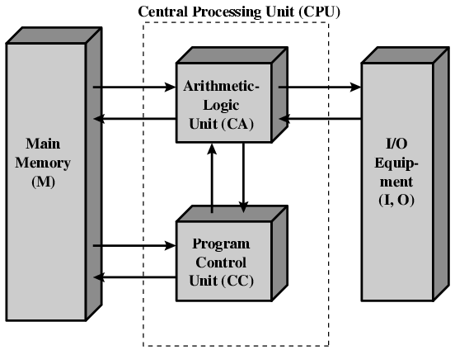
Structure of von Neumann machine

Slide 5
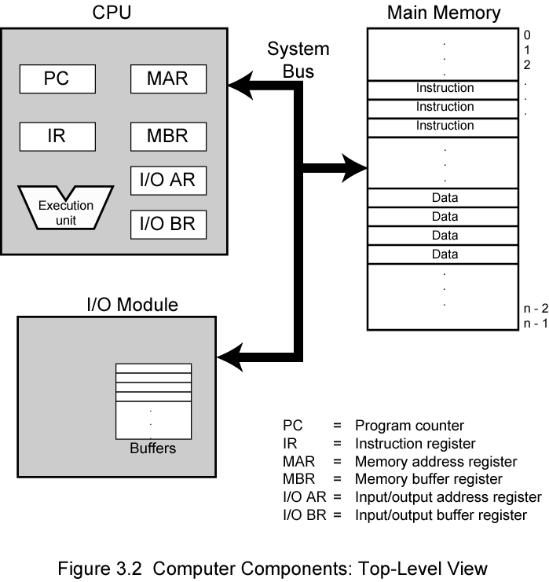
Computer Components: Top Level View

Slide 6
Connecting
All the units must be connected
Different type of connection for different type of unit
Memory
Input/Output
CPU (internal to processor)

Slide 7
What is a Bus?
A communication pathway connecting two or more devices
Usually broadcast
Often grouped
A number of channels in one bus
e.g. 32 bit data bus is 32 separate single bit channels

Slide 8
Data Bus
Carries data
Remember that there is no difference between “data” and “instruction” at this level
Width is a key determinant of performance
8, 16, 32, 64 bit

Slide 9
Address bus
Identify the source or destination of data
e.g. CPU needs to read an instruction (data) from a given location in memory
Bus width determines maximum memory capacity of system
e.g. 8080 has 16 bit address bus giving 64k address space

Slide 10
Control Bus
Control and timing information
Memory read/write signal
Memory/Input-output
Interrupt request
Clock signals
Synchronization signals

Slide 11
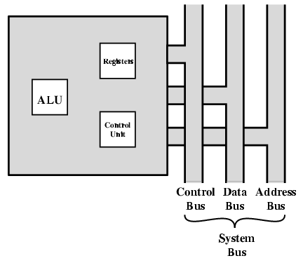
CPU With Systems Bus

Slide 12
Memory Connection
Receives and sends data
Receives addresses (of locations)
Receives control signals
Read
Write
Timing (Speed of processor and memory)

Slide 13
Memory Connection
Timing (Speed of processor and memory)

Slide 14
Semiconductor Memory
Type of memory
RAM
ROM
Categories of ROM
ROM
PROM
EPROM
EEPROM

Slide 15
Input/Output Connection
Similar to memory from computer’s viewpoint
Output
Receive data from computer
Send data to peripheral
Input
Receive data from peripheral
Send data to computer

Slide 16
Computer Components: Top Level View

Slide 17
Data Bus and Address Bus
Size of Address Bus:
SIZE | BINARY | DEC | HEXA
8 | 0000 0000 | 0 | 00
8 | 1111 1111 | 255 | FF
8 | 0101 0111 | 87 | 57
8 | 0000 0110 | 6 | 06
10 | 11 1111 1111 | 1023 | 3FF
12 | 1111 1111 1111 | 4095 | FFF
16 | 1111 1111 1111 1111 | 2¹⁶ -1 | FFFF
20 | 1111 1111 1111 1111 1111 | 2²⁰ -1 | FFFFF
30 | 11 ………………………….. 1111 | 2³⁰ -1 | 3FFFFFFF
32 | 1111 ………………………… 1111 | 2³² -1 | FFFFFFFF

Slide 18
Data Bus and Address Bus
Size of Address Bus and Memory Capacity:
SIZE | BINARY | DEC | HEXA | Capacity
8 | 0000 0000 | 0 | 00
8 | 1111 1111 | 255 | FF | 256
10 | 11 1111 1111 | 1023 | 3FF | 1K
12 | 1111 1111 1111 | 4095 | FFF | 4K
16 | 1111 1111 1111 1111 | 2¹⁶ -1 | FFFF | 64K
20 | 1111 1111 1111 1111 1111 | 2²⁰ -1 | FFFFF | 1M
30 | 11 ………………………….. 1111 | 2³⁰ -1 | 3FFFFFFF | 1G
32 | 1111 ………………………… 1111 | 2³² -1 | FFFFFFFF | 4G

Slide 19
Data Bus and Address Bus
Size of Data Bus/Memory Location:
SIZE | BINARY | DEC | HEXA
8 | 0000 0000 1111 1111 | 0 - 255 | 00 - FF
12 | 0000 0000 0000 1111 1111 1111 | 0 - 4095 | 000 - FFF
16 | 0000 0000 0000 0000 1111 1111 1111 1111 | 0 – (2¹⁶ – 1) | 0000- FFFF
20 | 0000 0000 0000 0000 0000 1111 1111 1111 1111 1111 | 0 – (2²⁰ -1) | 00000 - FFFFF
32 | 0000 ………………………….0000 1111 ………………………….1111 | 0 – (2³² -1) | 00000000 – FFFFFFFF

Slide 20
Capacity of memory module
Size of data bus, address bus and memory capacity

Slide 21
Test Items
Q1. Generally the speed of the memory is slower than the speed of the processor. Why? (Knowledge)
Q2. Explain the characteristics of different kind of ROMs
Q3. A memory module contains 1 G (Giga) memory location, what is the size of the address bus (Analysis)

Slide 22
Test Items
Q4. Consider a memory module with capacity 4 MB (Mega Byte). What is the size of address bus and data bus if the memory module is (Analysis)
(i) Byte organized
(ii) word organized (word = 16 bits)
(iii) long word organized (long word = 32 bits)
Q5. How to distinguish the address of a memory location and the address of a I/O device if the same address bus is used for addressing. (Design)

Slide 23
Test Items

